Slide 1

Microsoft Cloud for Healthcare
Build, extend, and enrich a connected experience across data, workflow, and cloud scale analytics
© 2020 Microsoft Corporation All rights reserved. Version 3.1 8.3.20

Slide 2
Microsoft Cloud for Healthcare | Partner walking deck
Why the Microsoft Cloud for Healthcare?
Healthcare in transition
WHY?
WHO?
WHAT?
Partner opportunity Systems Integrator
ISV
Partner benefits
Partner ecosystem
Introducing the Microsoft Cloud for Healthcare
Healthcare outcomes
HOW?
How the Microsoft Cloud for Healthcare comes to life
Capabilities and features overview
© 2020 Microsoft Corporation All rights reserved
2
Notes:
This presentation provides an overview of the Microsoft Cloud for Healthcare and the partner opportunity to build up, extend and enable Healthcare customers through the breadth of ecosystem solutions partners build.
WHY: We will start by highlighting the market factors that drove the Microsoft prioritization of the healthcare cloud.
WHAT: Then we will look at the cloud itself and the outcomes we are focused on enabling for our customers.
HOW: We will look at how the Cloud comes to life through a combination of Microsoft and partner solutions
WHO: And provide an in-depth view of how partners add value
T: Let’s start by looking at the healthcare market landscape

Slide 3

WHY

Slide 4




Microsoft Cloud for Healthcare
Better experiences. Better insights. Better care
The Microsoft Cloud for Healthcare is a purpose-driven offering, enabling our Partners to help Healthcare customers respond, recover, and reimagine their future.
COVID-19 has impacted the Healthcare industry with unprecedented challenges and provides a clear use case for accelerating innovation. Healthcare organizations face an immediate need for solutions they may not have.
© 2020 Microsoft Corporation All rights reserved
4

Slide 5








Healthcare in transition
COVID-19 disruption and challenges
70%
200,000
⬇Margins
Crisis
Restored
Average amount of elective procedures cancelled in Q2 plummeting income while expenses escalate
Cancer screenings paused each week in Great Britain’s NHS
And low cash flow forcing partnerships and M&A to survive with depleted reserves
Role of healthcare leaders to move from managing the crisis to reinvent a successful future
Ongoing Healthcare system impacts
81%
$6.2B
41%
14 million
Patients are unsatisfied with their current healthcare experience
Loss per year to data breaches, amid growing pressures in security and compliance
Providers say data and analytics challenges is preventing them from succeeding in value-based care models
By 2030, providers will suffer from a projected shortage of healthcare workers worldwide
© 2020 Microsoft Corporation All rights reserved
5

Slide 6

WHAT

Slide 7
Introducing the Microsoft Cloud for Healthcare
Enhance patient engagement
Empower health team collaboration
Improve clinical and operational data insights
Enabling enriched data to flow securely through every point of care to continuously improve patient's experience and health outcomes
Accelerating health teams’ ability to coordinate care in a secure environment and simplify complex workflow management
Connecting data from across systems, creating insights to predict risk and help improve patient care, quality assurance, and operational efficiencies
Trusted platform with unmatched security and privacy
© 2020 Microsoft Corporation All rights reserved
7

Slide 8
Capabilities enabling better experiences, better insights, better care
PERSONALIZED CARE Build relationships through enhanced experiences.
CARE TEAM COLLABORATION Optimize resources & solve problems collectively.
Enhance patient engagement
PATIENT INSIGHTS Transform data into prescriptive insights.
CARE COORDINATION Develop systems of engagement with intelligent workflows.
Better Experiences
Better Care
VIRTUAL HEALTH Provide new avenues for care.
CONTINUOUS PATIENT MONITORING Combine IOT & analytics to optimize treatments.
Empower health team collaboration
Better Insights
CLINICAL ANALYTICS Access and securely share actionable data to help improve patient care.
DATA INTEROPERABILITY Create new healthcare systems of engagement by connecting data from multiple systems of record
Improve clinical and operational data insights
OPERATIONAL ANALYTICS Gain actionable insights to optimize operations.
© 2020 Microsoft Corporation All rights reserved
8

Slide 9











Microsoft Cloud for Healthcare defined
The Cloud is available as an optional add-on with Healthcare specific capabilities and features
Microsoft Cloud for Healthcare add-on SKU
Cross-cloud engineering ownership, governed by executive leadership
SaaS based subscription
Updated regularly Minor and major releases
Cross Healthcare verticals capabilities Provider | Payor & Insurer | BioPharma & MedTech

Slide 10

HOW

Slide 11




How the Microsoft Cloud for Healthcare comes to life
Healthcare comes to life
How it works
Partner solutions
Healthcare specific
Vertically aligned
+
Applications and services
+
Healthcare configurations and features
Patient Outreach
Provider/Payer Contact Center
Physician Referrals
Resource Scheduling & Management
Patient Experience
Patient Management (Patient 360)
Provider Relations
Care Management
Remote Care Provider
Task Management
Virtual healthcare
Care Team Collaboration
Knowledge Management
+
Health data models and capabilities
Templates
HL7 & FHIR standards
AI models
Dashboards, workflows, and extensions
Connectors
Healthcare Common Data Models (CDM)
Provider: Admin, clinical, diagnostic and medication | Payor: Claims, benefits
© 2020 Microsoft Corporation All rights reserved
11

Slide 12
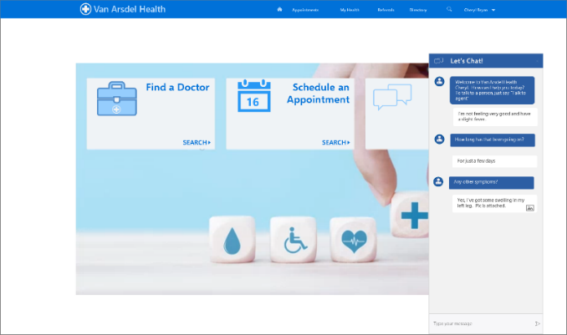
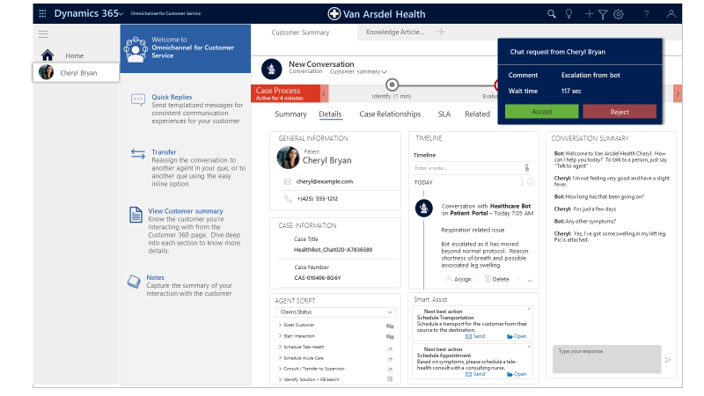
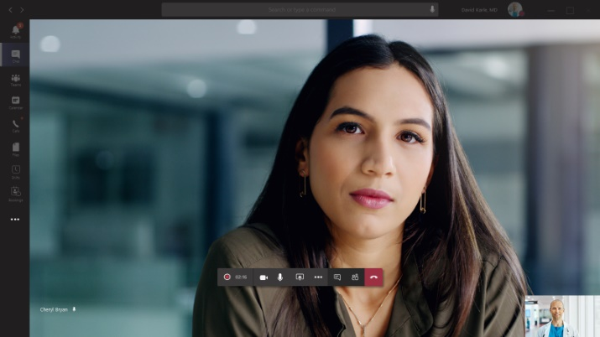
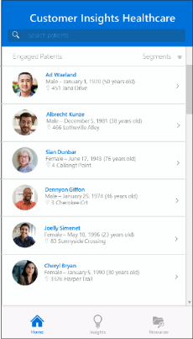
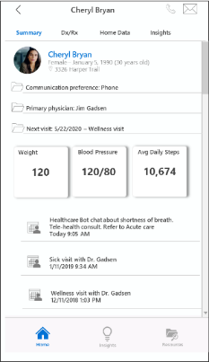




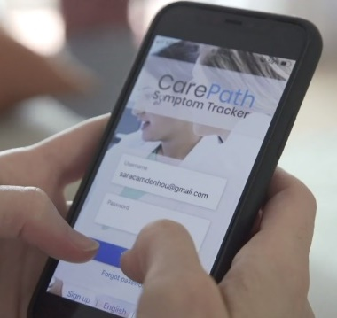
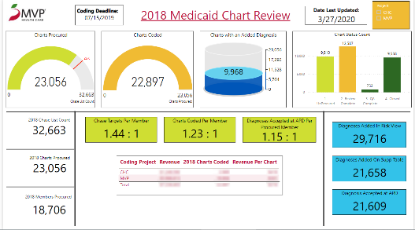
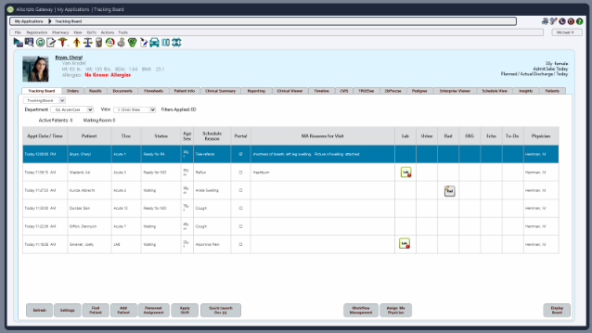
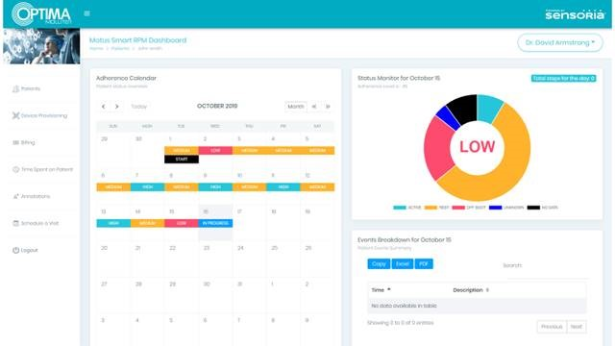
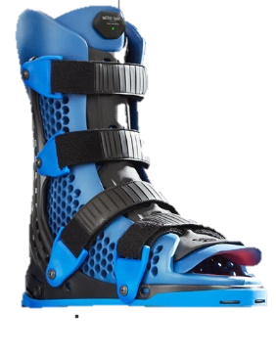
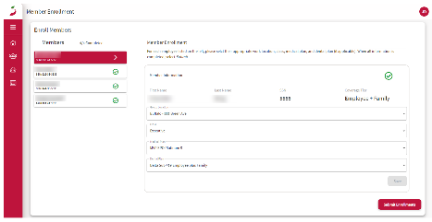




How the Microsoft Cloud for Healthcare comes to life
Healthcare comes to life
Microsoft Cloud for Healthcare
Partner built, extended, and enriched connected experiences
Healthcare specific
Vertically aligned
© 2020 Microsoft Corporation All rights reserved
12
Notes:
Which results in a rich set of solutions for Healthcare customers that deliver rich capabilities from our partners—both including embedded capabilities part of the Microsoft Cloud for Healthcare and others that are just part of the rich ecosystem of vertically-aligned solutions
Mazikglobal’s MazikCare software includes the Microsoft Healthcare bot to enable faster COVID-19 testing
Hitachi Solutions partnered with MVP Health Care to create a centralized collaboration platform that is cross Dynamics 365, Microsoft 365 and Azure
Allscripts Sunrise EMR provides capabilities for providers and clinicians
And Sensoria Health has developed Motus Smart, the world’s first smart diabetic footwear which leveraged the new Azure IoT Connector for FHIR and Azure Continuous Patient Monitoring with customers such as Ranchos Los Amigos rehabilitation center.
T: Let’s look more fully as the 14 solution capabilities and 80 features of the Microsoft Cloud for Healthcare

Slide 13
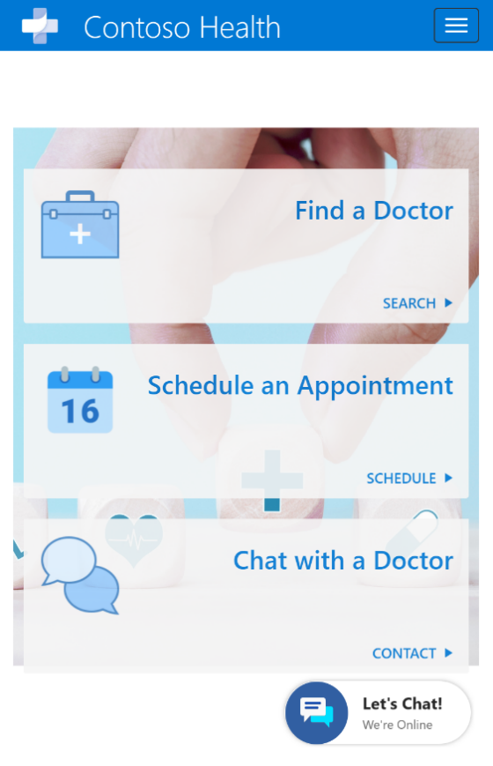
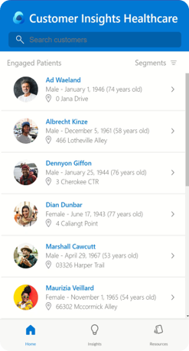
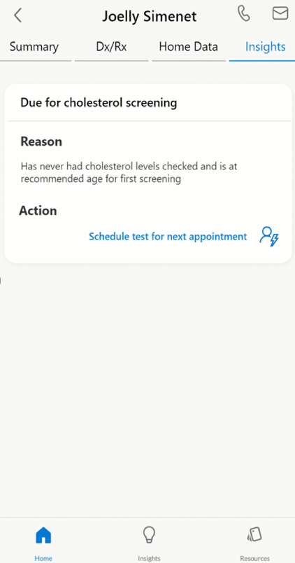
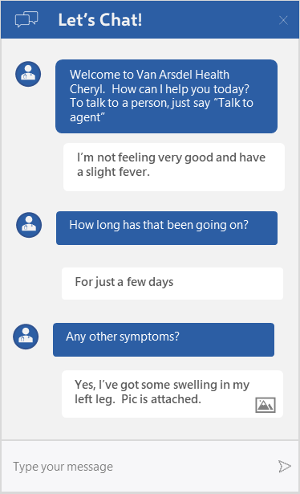



Patient experience and access to care
Digital patient engagement for scheduling, proactive wellness outreach; on-going virtual patient follow-up in surveys, assessments
Features
Microsoft Technologies
Patient Mobile and Web Platforms​
Patient Engagement Portal​
Scheduling ​
Upcoming Activities​
Care Reminders, Prescription Reminder​
Wellness Coaching​
Patient Follow-Up​
Patient Virtual Follow-Up, Patient Surveys​
Provider Outreach​
Patient Education​
Physician Directory​
Patient Assessments​
Crisis response Power App with Healthcare Bot Integration
Microsoft Power Automate
Microsoft Power Apps
Microsoft Healthcare Bot
Microsoft Power Virtual Agent
Azure API for FHIR
Dynamics 365 Customer Insights
© 2020 Microsoft Corporation All rights reserved
13
Notes:
Patient experience and access to care delivers digital patient engagement capabilities for patient scheduling, wellness outreach and ongoing virtual patient care as well as follow-up surveys and assessments and is built within Dynamics 365 Customer Insights, and a PowerApp and leverages workflows in Power Automate, the Microsoft Healthcare Bot and the Azure API for FHIR for HL7 and FHIR compliant data exchange.

Slide 14
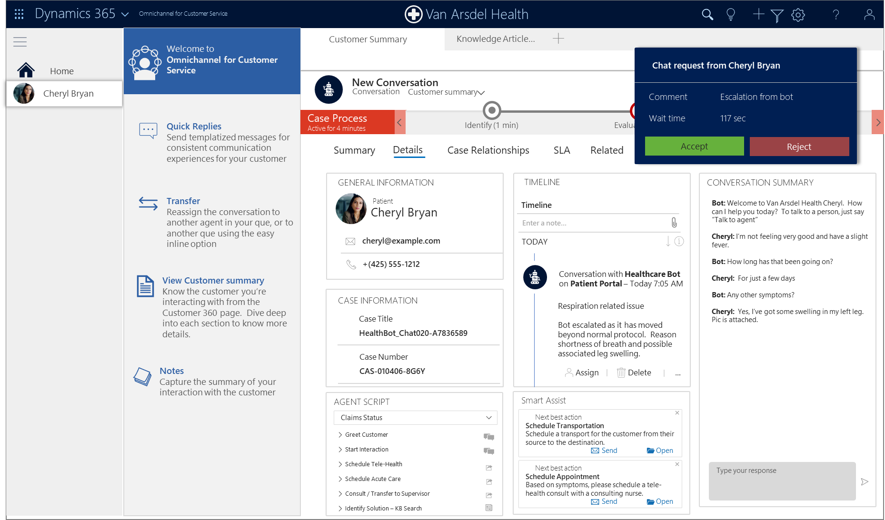
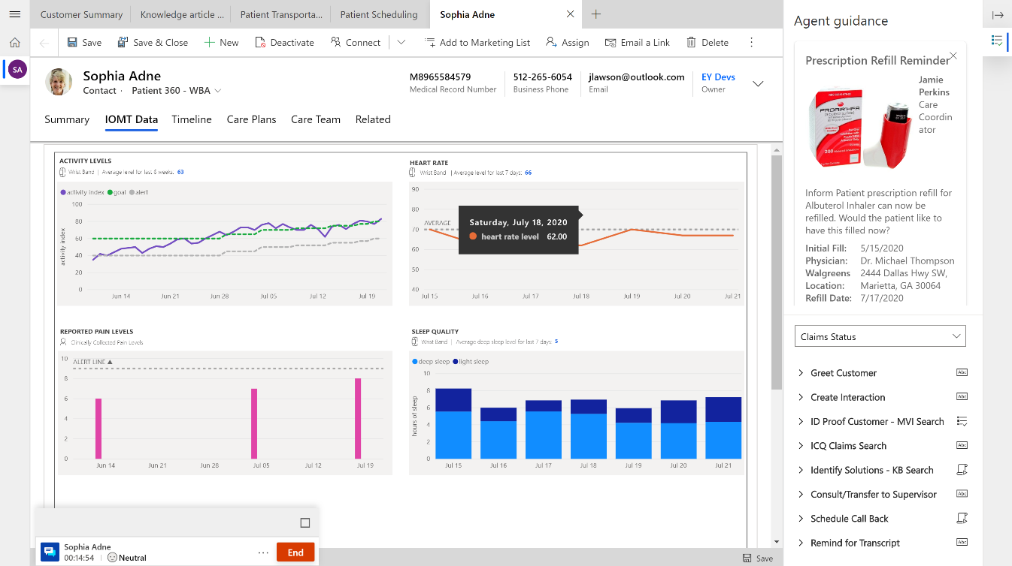
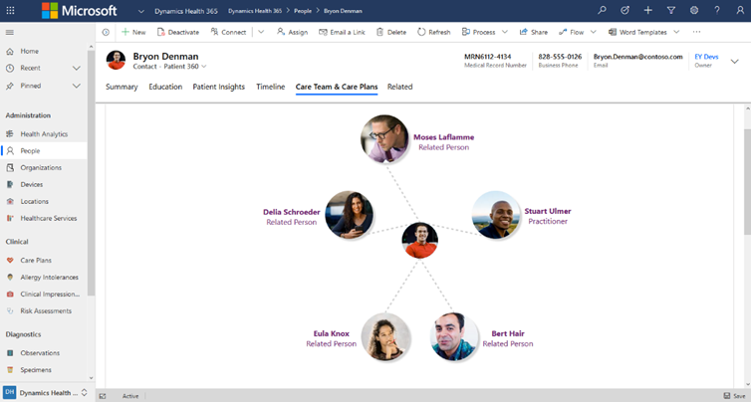
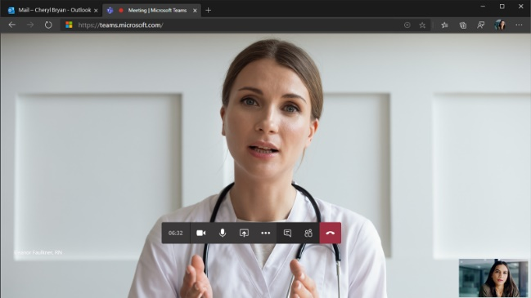

Patient Engagement & Contact Center
360 view of patient engagement and activity across the care system. Enable organizations to automate response to inquiries, provide guidelines, answer questions, and guide people to centers of care appropriately
Features
Microsoft Technologies
Patient Management ​ Patient 360​
Health Timeline​
Care Team Map​
Care Plan Monitoring​
Knowledge Management​
Wellness Coaching​
Scheduling Omni-channel Engagement​
Post-discharge Text Msg | Emails | Surveys​
Automated Engagement (Health Bot)​
On-Demand Virtual Visits
Dynamics 365 Customer Service | Omni Channel
Microsoft Healthcare Bot
Azure API for FHIR
Azure IoT Connector for FHIR
Microsoft Teams
Microsoft Bookings | Bookings API
© 2020 Microsoft Corporation All rights reserved
14
Notes:
Patient engagement and contact center provides the 360-degree view of patient engagement that we discussed and provides visibility to activities across the care continuum. It helps enable organizations to automate response to inquiries, provide guidelines, answer questions, and guide people to centers of care appropriately
It is built on Dynamics 365 Customer Service with Omni Channel, Microsoft Teams, Bookings and the Bookings API as well as the Healthcare bot, Azure API for FHIR and the Azure IoT Connector for FHIR

Slide 15
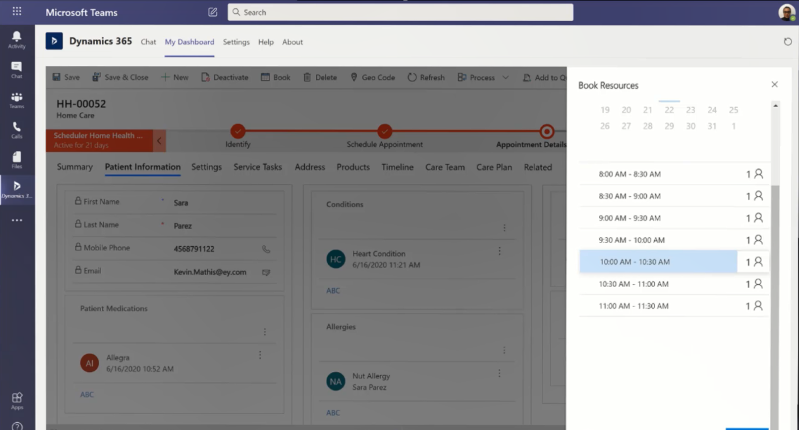
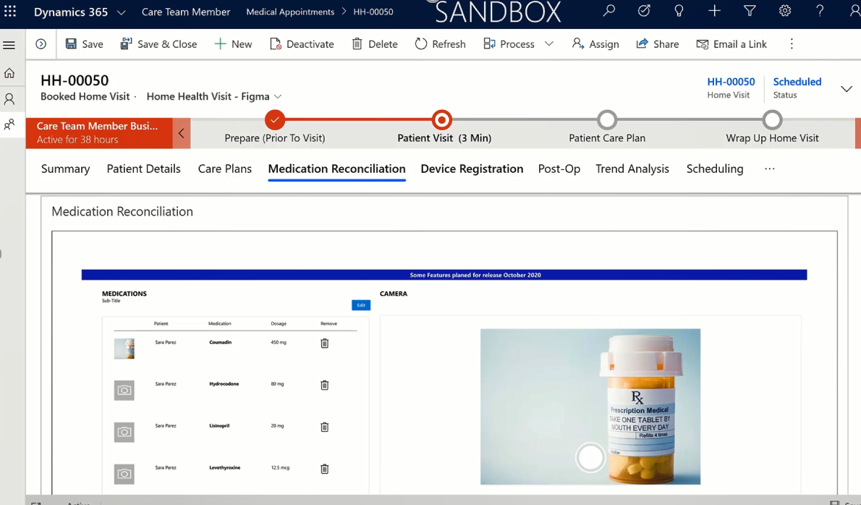
Home Health & Resource Management
Enable at home skilled medical care as an affordable alternative to facility or hospital care
Features
Microsoft Technologies
Resource Scheduling​
Resource Management (Equipment Ordering & Management)​
Route Optimization​
Remote Monitoring​
Prescription Monitoring​
Virtual Visit
Medication Reconciliation
Device Registration
Dynamics 365 Field Service
Dynamics 365 Customer Insights
Microsoft Power Automate
Microsoft Power Apps
Microsoft Teams
Azure API for FHIR
© 2020 Microsoft Corporation All rights reserved
15
Notes:
Home Health & Resource Management enables at home skilled medical care as an affordable alternative to facility or hospital care. This is one of the two capability areas engineering is still developing and it is built on Dynamics 365 Customer Service and Customer Insights and Microsoft Teams virtual health capabilities

Slide 16
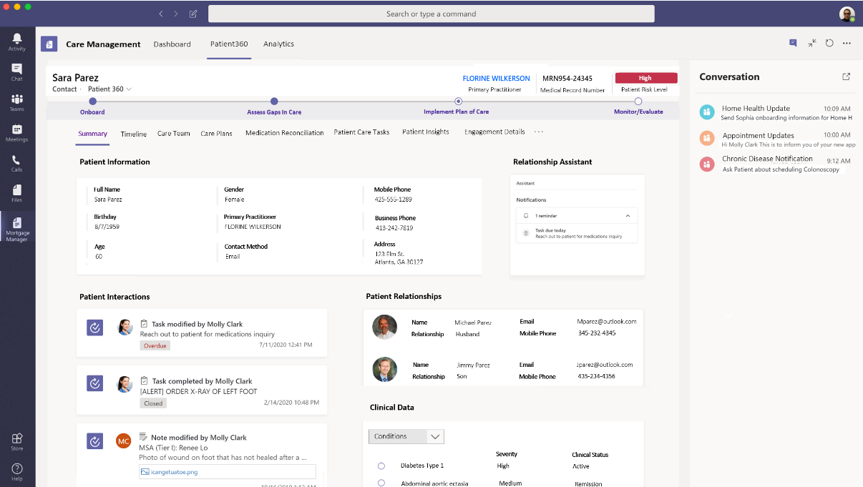
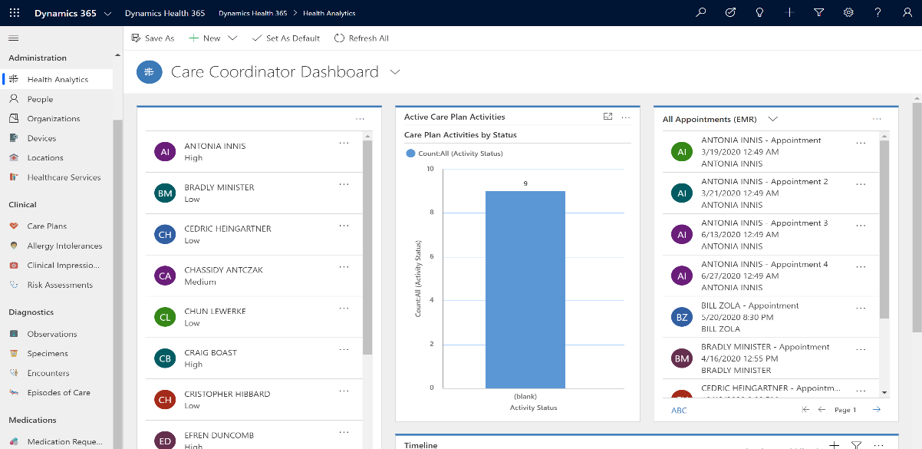
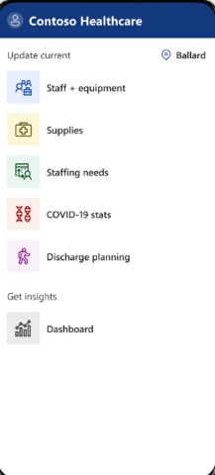
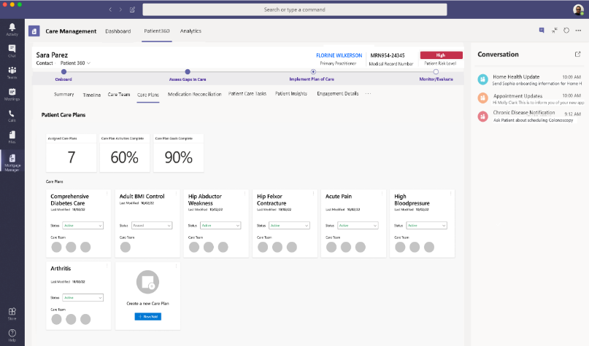
Care Management and Coordination
Enhanced care team communication to enable more efficient workflow management (i.e. bed, equipment, discharge, staffing) and provide visualization for meaningful care insights
Features
Microsoft Technologies
Care Management​
Virtual Visit​s
Care Team Collaboration​
Care team communication ​
Care Plan Development​
Care Plan Personalization​
Care Plan Enrollment​
Care Management Analytics​
Equipment Ordering & Management​
Utilization Management (Benefits usage, gaps, efficiencies) ​
Dynamics 365 Field Service
Dynamics 365 Customer Insights
Microsoft Teams
Azure API for FHIR
© 2020 Microsoft Corporation All rights reserved
16
Notes:
Care Management and Coordination provides enhanced care team communication to enable more efficient workflow management and provide visualization for meaningful care insights. This is the other capability area that engineering is still developing right now.
It also delivers Healthcare specific features for Dynamics 365 Field Service and Customer Insights and Microsoft Teams

Slide 17
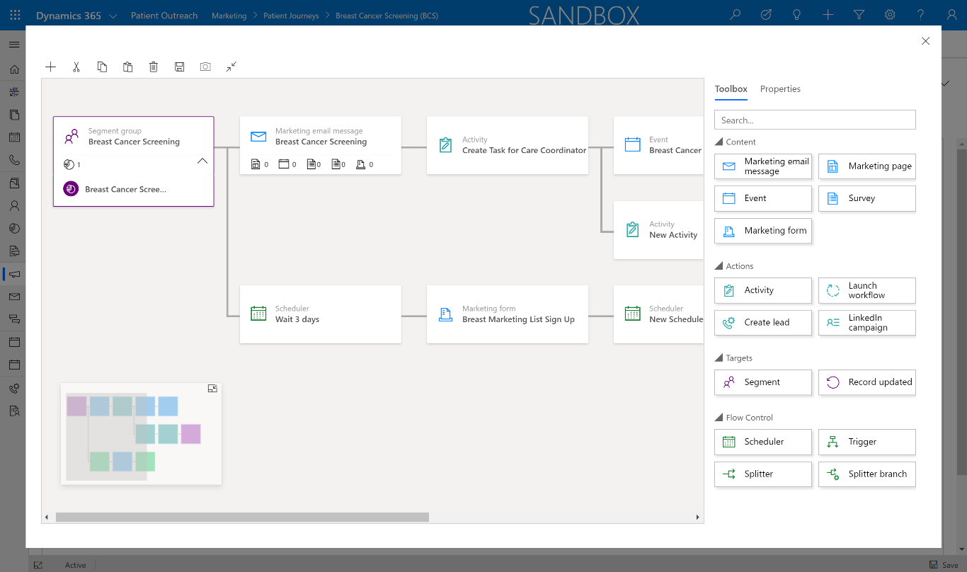
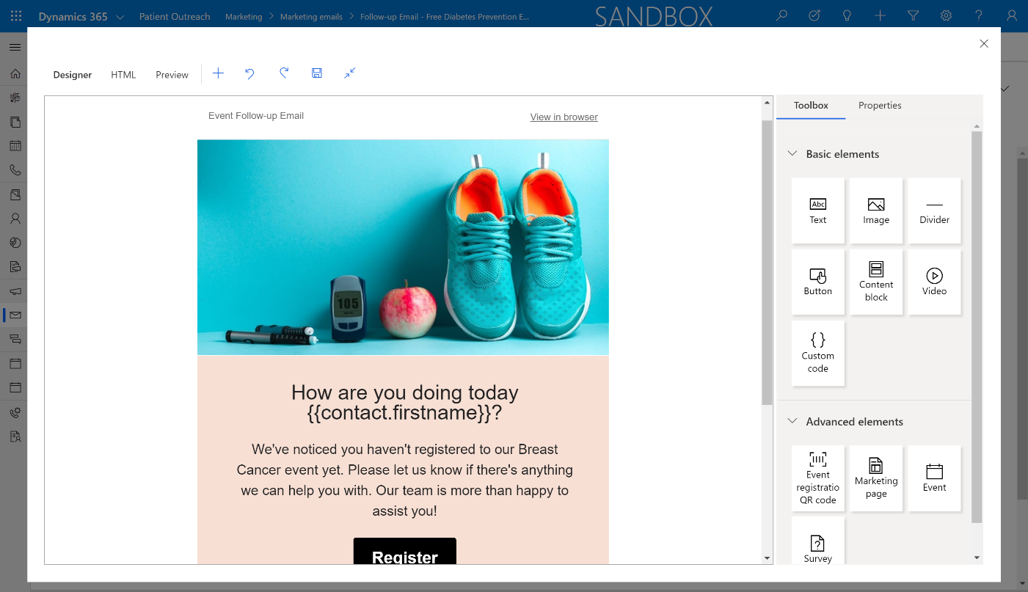
Patient and Consumer Outreach & Marketing
Efficient new patient acquisition and creation of personalized consumer nurture journeys
Features
Microsoft Technologies
Patient Segmentation​
Patient Journey Automation​
Patient Personalized Engagement​
New Patient Outreach
Lead Scoring​
New Patient Enrollment​
Event Management​
Patient Outreach Templates
Dynamics 365 Marketing | Event Portal
Dynamics 365 Customer Insights
Microsoft Healthcare Bot
Microsoft Power Virtual Agent
Azure API for FHIR
© 2020 Microsoft Corporation All rights reserved
17
Notes:
Patient and Consumer Outreach & Marketing is built on Dynamics 365 Marketing and its Event Portal as well as Dynamics 365 Customer Insights and the Azure Healthcare capabilities and delivers capabilities for efficient new patient acquisition and creation of personalized consumer nurture journeys

Slide 18
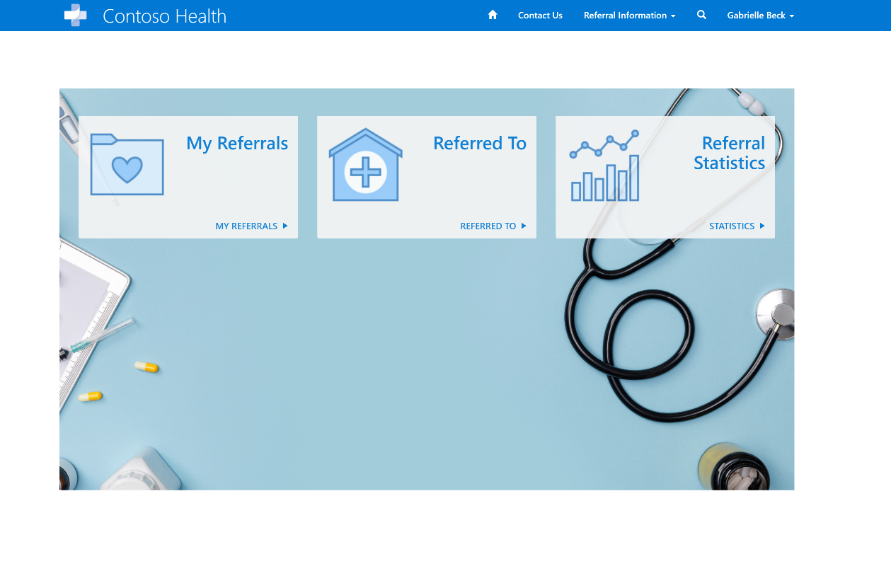
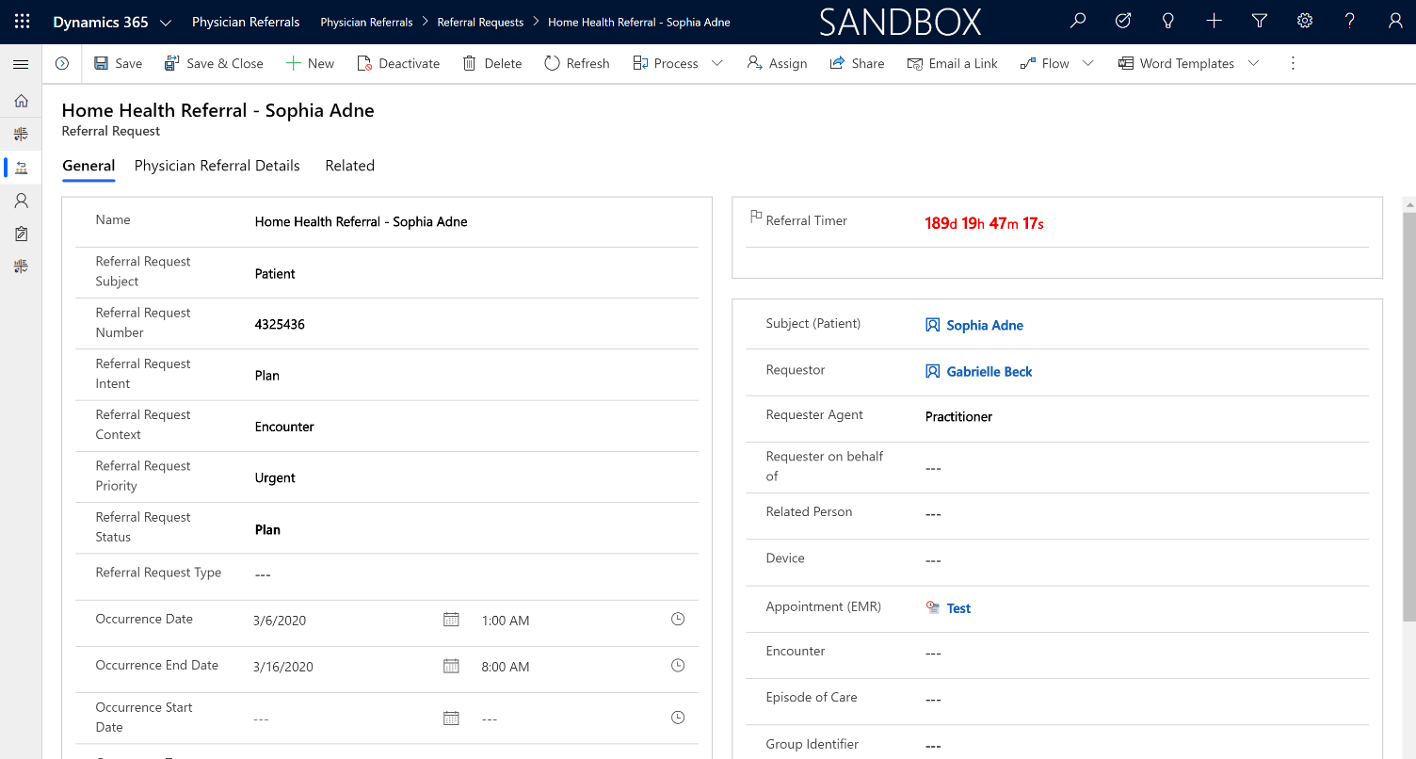
Physician Relationship Management
Provider referral management for increased client retention and care satisfaction
Features
Microsoft Technologies
Referral & Preference Management​
Provider Search (Location / Capability)​
Physician Liaisons App​
Referral Analytics (Perception)​
Client Analytics (increase client retention)
Dynamics 365 Sales
Microsoft Power Automate
Microsoft Power Apps
Microsoft Healthcare Bot
Microsoft Power Virtual Agent
Azure API for FHIR
Microsoft Teams
© 2020 Microsoft Corporation All rights reserved
18
Notes:
Physician Relationship Management delivers Health Provider referral management for increased client retention and care satisfaction and leverages Dynamics 365 Sales, Azure Healthcare features and Microsoft Teams

Slide 19
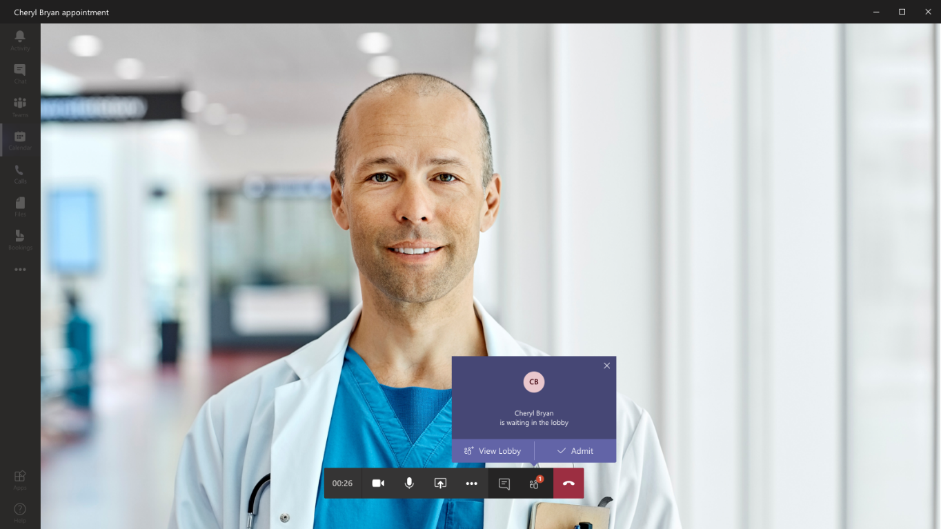
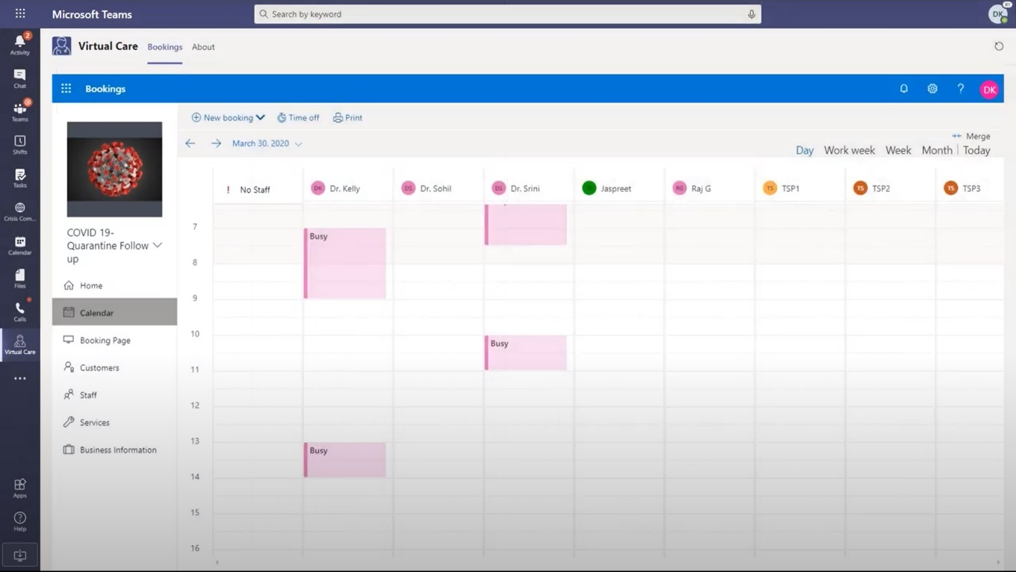
Virtual visits
More effective, real-time conversations and intelligent meetings
Features
Microsoft Technologies
Join online meetings with HD video, VoIP, and dial-in audio conferencing options
Mobile, desktop, browser and certified devices
One-touch join with Microsoft Teams Rooms
Support for Surface Hub and existing rooms
Guest Meeting Join Support for External Attendees (including plugin-less meeting join)
Related files and chat history at your fingertips
Cloud recording of meetings
Microsoft Teams
Microsoft Bookings
Microsoft Bookings API in Microsoft Graph
© 2020 Microsoft Corporation All rights reserved
19
Notes:
Microsoft Teams virtual visits capabilities enable virtual health for providers including real-time conversations and intelligent appointments with patients built on Microsoft Teams, Bookings and the Bookings API available in Microsoft Graph.
Not only do virtual meetings give clinicians a way to relay the most relevant patient information to support strong hand-offs across the healthcare team, they also capture the information for future reference. Clinicians can access meeting recordings with transcribed text that are indexed, searchable, and can be translated with a simple click.

Slide 20
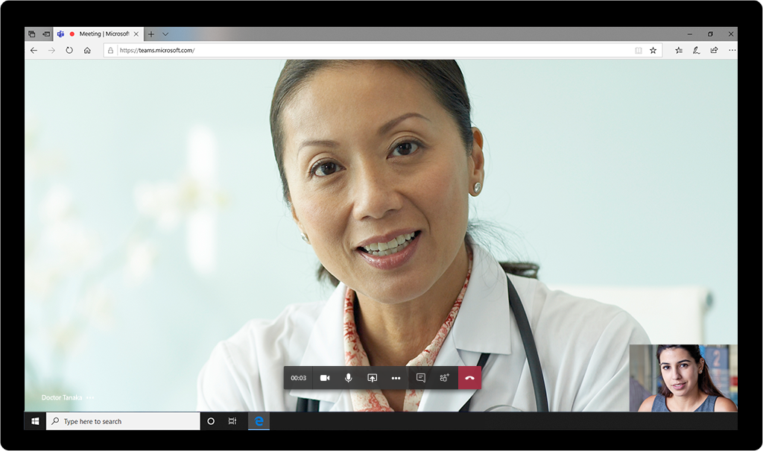
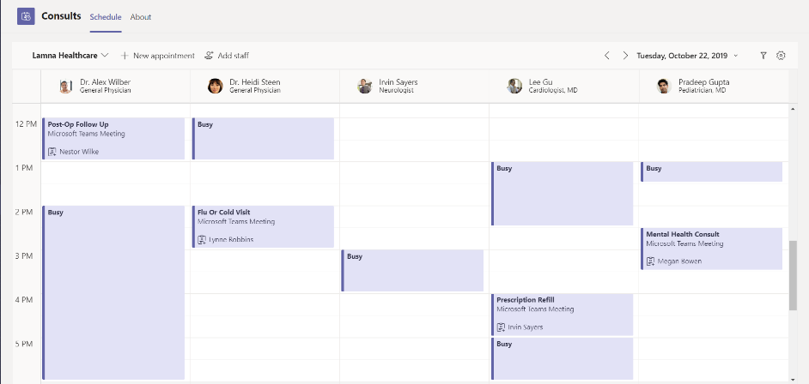
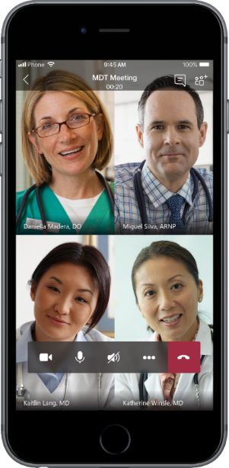
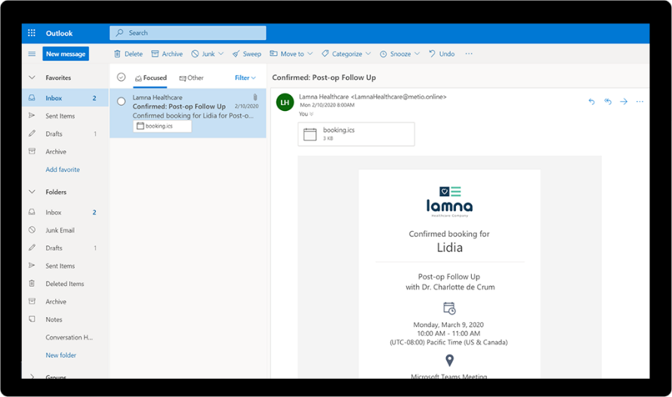
Virtual consults
Clinician to clinician | Clinician to patient | Virtual rounding
Features
Microsoft Technologies
Join online meetings with HD video, VoIP, and dial-in audio
Cloud recording of meetings
Meet across multiple devices
Intuitive and customizable email invite
External attendee join via WebRTC in web browser or Teams Mobile App
Attendee arrival notification
Simple tool for creating virtual appointments
Admins can manage multiple departments and staff
Sends notifications and reminders
Online Meeting Graph APIs for customized scheduling
Microsoft Teams
Microsoft Bookings
Microsoft Bookings API in Microsoft Graph
© 2020 Microsoft Corporation All rights reserved
20
Notes:
Virtual Consults are also available now on Microsoft Teams and provide patient to clinician, clinician to clinician, and virtual rounding capabilities. Administrators can access a scheduling view across all of the clinicians in the care team. They can select an appointment with any clinician, and fill out the fields, input the relevant notes about the appointment, and click send.
The patient will then receive an email with details about the appointment and a Teams meetings link. The best thing is they don’t even need Teams to participate, the patient just needs a web browser and can join in one click.

Slide 21
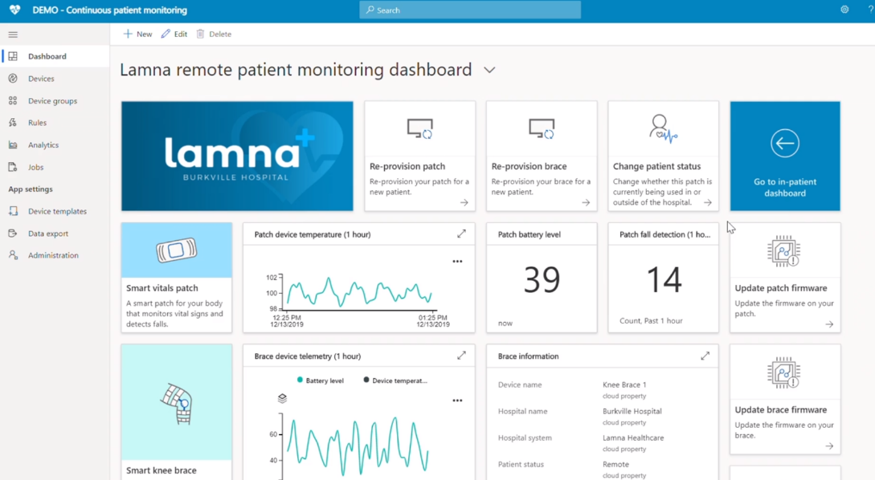
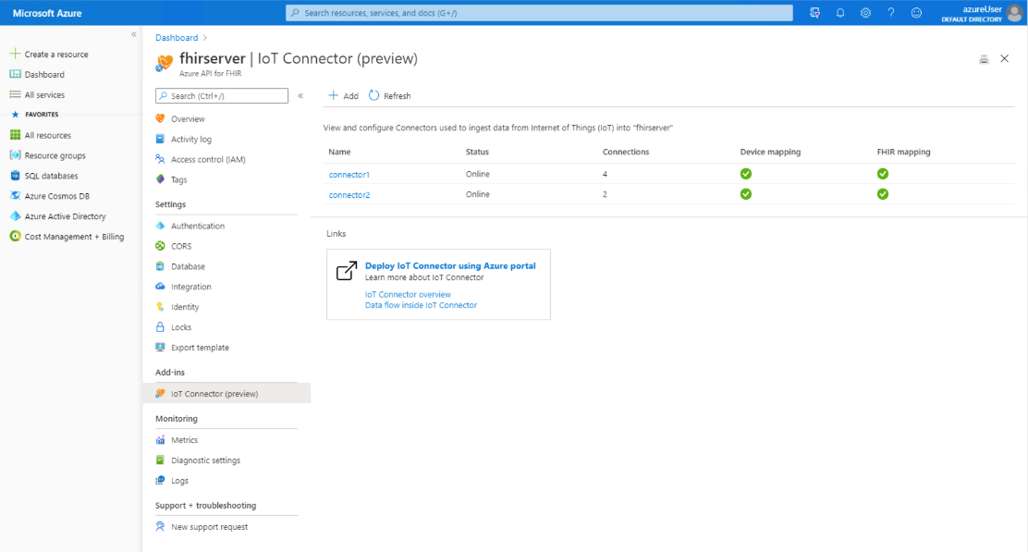


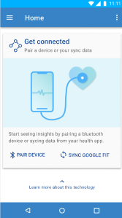
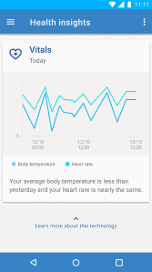

Healthcare interoperability, IoT, and patient monitoring
Drive data interoperability and IoT connectivity for IoT devices, sensors and healthcare apps and systems
Features
Microsoft Technologies
Azure API for FHIR
Health data interoperability
Secure PHI management and compliance
AI, ML, and data analytics workloads acceleration
Azure IoT Connector for FHIR
Managed feature of Azure API for FHIR
Help meet security and compliance requirements
Normalize device data
Convert to FHIR Observations
Support for sub second
Scalable with new workloads
Seamless connection with Azure IoT
Continuous patient monitoring
Hospital care team data visualization
Real-time streaming dashboard for patient vitals
Connectivity to Azure IoT Central
Logic app connectivity
Stream data to Power BI
Azure API for FHIR
Azure IoT Connector for FHIR
Continuous patient monitoring template on Azure IoT Central
© 2020 Microsoft Corporation All rights reserved
21
Notes:
For Healthcare system integration, IoT, and ongoing patient care the Microsoft Cloud for Healthcare delivers Azure capabilities that drive continuous patient monitoring, data interoperability, and IoT connectivity for IoT devices, sensors and healthcare apps and systems

Slide 22

WHO

Slide 23
Healthcare Partner opportunity
Build, extend, and enrich a connected experience across data, workflow, and cloud scale analytics
Build
Accelerate
Unlock
Build on healthcare-specific standards & capabilities
Accelerate development and time to market
Unlock revenue and services opportunities
Enable inspired experiences and outcomes for care, collaboration, communication, and insights, building on and extending a managed healthcare platform
Accelerate development and time to market for vertically-aligned and LOB specific applications and IoT devices that bring the cloud capabilities to life
Unlock new revenue opportunities by delivering high-value services for functional implementation, data governance, adoption, and interoperability
© 2020 Microsoft Corporation All rights reserved
23

Slide 24










Healthcare Partner opportunity | Systems Integrator
Build
Accelerate
Unlock
Functional implementation
Drive MS Cloud for Healthcare functional implementation and customization based, tailoring the solution based on each customer’s unique needs and business processes
Feature integration
Embed Healthcare Cloud capabilities or features into your or your customers’ existing or new bespoke SaaS, PaaS, or other solutions
Extend capabilities
Extend Healthcare Cloud capabilities by integrating with Microsoft platform or ISV Healthcare solutions or services
Services
Help customers connect data silos, enabling interoperability with the Healthcare Cloud, cloud scale and predictive analytics, data reasoning, and actionable insights
Use case
Workflows customization
BI dashboards
Dynamics 365 Customer Service
Dynamics 365 Field Service
Healthcare Bot
Patient & clinical CDMs
Healthcare Bot
Virtual health
Azure API for FHIR
Azure IoT Connector for FHIR
Configurations
EMR/EHR connectors
IoT, IoMT devices
ISV SaaS app | PaaS solution
Azure Synapse | Analytics Services
Mixed reality
EMR/EHR integration
Azure API for FHIR
Power BI dashboards
Predictive AI/ML
Examples
© 2020 Microsoft Corporation All rights reserved
24
Notes:
.

Slide 25
Healthcare Partner opportunity | ISV
Build
Accelerate
Unlock
Extend with vertical or LOB co-sell ready solutions
Extend and improve the Cloud ecosystem and expand your distribution footprint, building co-sell ready LOB or vertically-aligned apps that leverage the scale of the Microsoft Field
Embed Healthcare Cloud features
Accelerate and improve Healthcare app development by embedding Cloud capabilities into existing or new SaaS apps, PaaS, or other solutions
Integrate with your solutions
Connect Microsoft Cloud for Healthcare capabilities, integrating with your first party Healthcare apps or platforms
Implementation, analytics, and interoperability services
If you have a services arm, implement Microsoft Cloud for Healthcare along with your SaaS, PaaS, or other solutions
Use case
Dynamics 365 LOB apps
Dynamics 365 Health Payor & Insurer apps
Teams Productivity Canvas apps
PowerApps developed apps
CDM (Provider, Payor)
Healthcare Bot
Virtual health
Azure API for FHIR
Configurations
Workflow
Connectors
EMR connectors
Azure API for FHIR
Azure IoT Connector for FHIR
Workflow extension
Dynamics 365 connectors
Microsoft Teams connectors
Functional implementation
Data analytics, BI and reporting
System integration & interoperability
Examples
© 2020 Microsoft Corporation All rights reserved
25
Notes:
.

Slide 26

Key Microsoft Partner takeaways
Everything Partners do today is still viable: Apps, capabilities, devices, services
Most Healthcare vertical-specific capabilities continue to be delivered by Partners
Partner platforms or apps do not require re-platforming for the Healthcare Cloud
Still run on Azure, Teams, Dynamics, etc.
There is just more we can do together in this connected, interdependent ecosystem
Build. Extend. Enrich. Connect
© 2020 Microsoft Corporation All rights reserved
26
Notes:
One of the questions Partners ask is whether they must re-platform their existing SaaS, PaaS, or other solutions and the answer is no. Everything that Partners do today is still viable.
Most healthcare vertical-specific capabilities will continue to be delivered by Partners through the rich ecosystem that exists today.
Additionally, partners can build-on, extend to, enrich with and connect to their custom bespoke and cloud scale apps and solutions.

Slide 27






























































































Healthcare Partner ecosystem¹
ASCENT SOLUTIONS
Better Experiences
Better Care
Better Insights
1. Representative partners, not a complete list
© 2020 Microsoft Corporation All rights reserved
27
Notes:
The breadth of the Microsoft Healthcare ecosystem continues to grow. Here is just a sampling of Healthcare ISV or SI partners.
As our partners continue to build on and extend our core platforms and healthcare capabilities, customers will realize the benefits and outcomes that improve the quality of care, increase care team collaboration and communication, and foster actionable insights to drive ongoing improvement

Slide 28





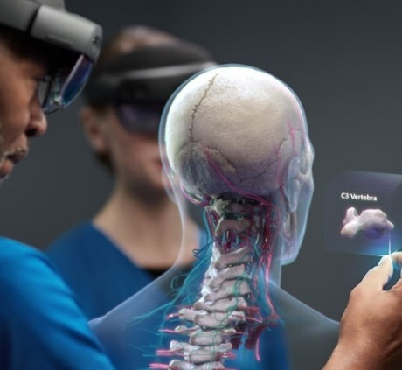



Empowering Healthcare Partners to do more
Build, extend, and enrich a connected experience across data, workflow, and cloud scale analytics
Trust
Global Scale
Security & Compliance
We never monetize your or your customers’ data
Industry leading cloud scale and partner ecosystem
Commitment to the most comprehensive security & compliance offerings
© 2020 Microsoft Corporation All rights reserved
28

Slide 29


Learn more. Go further
Programs
Demos | Summit
Resources
Microsoft Business Applications ISV Connect
Enhance patient engagement
Partner Healthcare site
Guided Experience website
Program Overview
Demo
Interactive tour
Microsoft Partner Network
Empower health team collaboration
Overview presentation
FAQ
Microsoft 365
Developer program
Demo
Microsoft Cloud for Healthcare
Microsoft Azure
Website
Blog
Microsoft Healthcare Summit
Partner program
C+AI partner community
Landing page
Build, extend, and enrich a connected experience across data, workflow, and cloud scale analytics
© 2020 Microsoft Corporation All rights reserved
29

Slide 30

Microsoft Cloud for Healthcare
Launched in Public Preview: May 19, 2020, with general availability to begin in the fourth quarter of the 2020 calendar year
Free six-month trial
© 2020 Microsoft Corporation All rights reserved
30

Slide 31

Replace this photo with the one from next slide.
Layout bottom to look good
Create a new icon that is representative of a doctor doing an online meeting with a patient like the photo shows. So the doctor in the icon below is great, just add a person and a PC monitor
Benefits & capabilities drill-down, architecture

Slide 32
Microsoft Cloud for Healthcare | One Microsoft Platform
Healthcare customers
Microsoft Partner solutions and services
Healthcare specific
Vertically aligned
Referral & Client Analytics
Patient Outreach
Provider/Payer Contact Center
Physician Referrals
Resource Scheduling & Management
Patient Experience
Patient Management (Patient 360)
Provider Relations
Care Management
Remote Care Provider
Task Management
Virtual visits, consults, & rounding
Care Team Collaboration
Knowledge Management
Healthcare Bot
Azure IoT Connector for FHIR
Azure API for FHIR service
Healthcare Provider or Payor & Insurer
Microsoft Power BI
Microsoft Dynamics 365
Microsoft PowerApps | Microsoft Power Automate
Microsoft Teams
Microsoft SharePoint
Multiple
Microsoft Azure
Services
Marketing
Omni-Channel
Sales
Field Service
Common Data Service
Microsoft Azure Data Lake Storage
Modern Workplace
Microsoft Azure
Microsoft Common Data Model for Healthcare
© 2020 Microsoft Corporation All rights reserved
32

Slide 33




Capabilities and dependencies overview
Scenario | Capabilities
Enhance patient engagement | Efficient new patient acquisition and creation of personalized consumer nurture journeys |  | ■
 | Digital patient engagement for scheduling, proactive wellness outreach; on-going virtual patient follow-up in surveys, assessments | ■ |  | ■ | ■
 | 360 view of patient engagement and activity across the care system (providers, payors) | ■ | ■ |  | ■
 | Enable organizations to automate response to inquiries, provide guidelines, answer questions, & guide people to centers of care appropriately | ■ | ■ |  | ■
Empower health team collaboration | Provider referral management for increased client retention and care satisfaction | ■
 | Enhanced care team communication to enable more efficient workflow management (i.e. bed, equipment, discharge, staffing) and provide visualization for meaningful care insights | ■ |  | ■
 | Enable at home skilled medical care as an affordable alternative to facility or hospital care | ■ | ■ | ■ | ■
 | Instantly report on available beds, equipment in use, COVID-19 related patients, and more. Know what's needed and what's available—everywhere in the facility | ■
Improve clinical and operational data insights | 360 view of member, deliver insights and better match patients with providers based on eligibility and benefits | ■
 | Enable continuous monitoring of patients and equipment to correlate multiple biometrics. Manage inventory levels to optimize costs |  |  |  | ■
 | Provider focused B2B & B2C Industry Data models that map to HL7 FHIR resources | ■
© 2020 Microsoft Corporation All rights reserved
33

Slide 34

Enhance patient engagement
Capability | Intelligent patient outreach: Efficient new patient acquisition and creation of personalized consumer nurture journeys | Patient access: Digital patient engagement for scheduling, proactive wellness outreach; on-going virtual patient follow-up in surveys, assessments | Patient contact center: 360 view of patient engagement and activity across the care system (providers, payors) | Member contact center: Enable organizations to automate response to inquiries, provide guidelines, answer questions, & guide people to centers of care appropriately
Features | Patient Segmentation​ Patient Journey Automation​ Patient Personalized Engagement​ New Patient Outreach Lead Scoring​ New Patient Enrollment​ Event Management​ Patient Outreach Templates | Patient Engagement Portal (Power Apps) Scheduling (Kyruus/Universal Resource Scheduling) Upcoming Activities Care Reminders Prescription Reminder Wellness Coaching Patient Follow-Up Patient Virtual Follow-Up Provider Outreach Patient Surveys Patient Education Physician Directory Patient Assessments Crisis response Power App with HealthBot Self-Assessment Integration | Patient Management (Model Drive App) Patient 360 Health Timeline Care Team Map Care Plan Monitoring Knowledge Management Wellness Coaching Scheduling (Kyruus) Omni-channel Engagement Post-discharge Text Msg / Emails / Surveys Automated Engagement (Health Bot) Omni-channel routing for crisis response | Symptom checker Disease self assessment Intelligent triage with credible medical protocols Policy Q&A (insurance claims, copays, etc.) Flexible flows for low-code configuration
Dependencies
Microsoft Healthcare Bot
Power Virtual Agent
Azure API for FHIR
Azure IoT Connector for FHIR
Microsoft Teams (Virtual visits, consults)
Microsoft Bookings | Bookings API
Dynamics 365 Marketing | Event Portal
Dynamics 365 Customer Service | Omnichannel | Dynamics 365 Customer Insights
Microsoft Power Automate
Microsoft Power Apps
© 2020 Microsoft Corporation All rights reserved
34

Slide 35
Empower health team collaboration
Capability | Physician Relationships and Referral Management: Provider referral management for increased client retention and care satisfaction | Care Management: Enhanced care team communication to enable more efficient workflow management (i.e. bed, equipment, discharge, staffing) and provide visualization for meaningful care insights | Home Health: Enable at home skilled medical care as an affordable alternative to facility or hospital care | Hospital emergency response: Instantly report on available beds, equipment in use, COVID-19 related patients, and more. Know what's needed and what's available—everywhere in the facility
Features | Referral & Preference Management Provider Search (Location / Capability) Physician Liaisons App Referral Analytics (Perception) Client Analytics (increase client retention) | Care Management​ Virtual Visit​s Care Team Collaboration​ Care team communication ​ Care Plan Development​ Care Plan Personalization​ Care Plan Enrollment​ Care Management Analytics​ Equipment Ordering & Management​ Utilization Management (Benefits usage, gaps, efficiencies) ​ | Resource Scheduling​ Resource Management (Equipment Ordering & Management)​ Route Optimization​ Remote Monitoring​ Prescription Monitoring​ Virtual Visit Medication Reconciliation Device Registration | Staff + equipment (Collect status of current number of patients, nurses on duty and critical equipment) Supplies (Track key supplies to track, manage, and forecast inventory more effectively via dashboard.) Staffing needs (Collect requests for personnel so it can be evaluated and resourced as appropriate) Discharge planning (Collect status and projections on patient discharges across facility to meet surge demands.) Emergency Response Dashboard (Dashboard view of all data / insights collected in mobile app)
Dependencies
Microsoft Healthcare Bot
Microsoft Power Virtual Agent
Azure API for FHIR
Microsoft Teams
Dynamics 365 Field Service
Dynamics 365 Customer Insights
Dynamics 365 Sales
Microsoft Power Automate
Microsoft Power Apps
© 2020 Microsoft Corporation All rights reserved
35

Slide 36
Improve clinical and operational data insights
Capability | 360 view of member, deliver insights and better match patients with providers based on eligibility and benefits | Enable continuous monitoring of patients and equipment to correlate multiple biometrics. Manage inventory levels to optimize costs | Provider focused B2B & B2C Industry Data models that map to HL7 FHIR resources
Features | Member 360 (enabled by the CDM) Enhancements to provider full view of insurance organization member | Continuous patient monitoring Inventory management for medical supplies Smart hospital equipment In-home care | Patient Data Model Clinical Data Model
Dependencies
Azure IoT for Healthcare
Azure IoT Connector for FHIR
Microsoft Power Apps
Patient Clinical Data (Integration to EMR)
© 2020 Microsoft Corporation All rights reserved
36

Slide 37
Microsoft Cloud for Healthcare logical architecture
Healthcare capabilities
Advisory Services
ISVs
Build industry or vertical specific solutions
Build bespoke Healthcare solutions
Extend solutions built on top of the Microsoft Cloud for Healthcare
Healthcare apps
System Integrators
Open standards
ISV cloud solutions
Workflows
Healthcare Capabilities
AI models
System Integrators, Advisory Services
Provide expertise for customer, ISV, and industry ISV solutions
Create their own or bespoke Healthcare industry solutions and tools
Create industry vertical solution support and practices to help customers directly, or support ISV deliverables
Provide strategic guidance for customers
Connectors
Templates
Configurations
Common data models (CDM)
© 2020 Microsoft Corporation All rights reserved
37

Slide 38
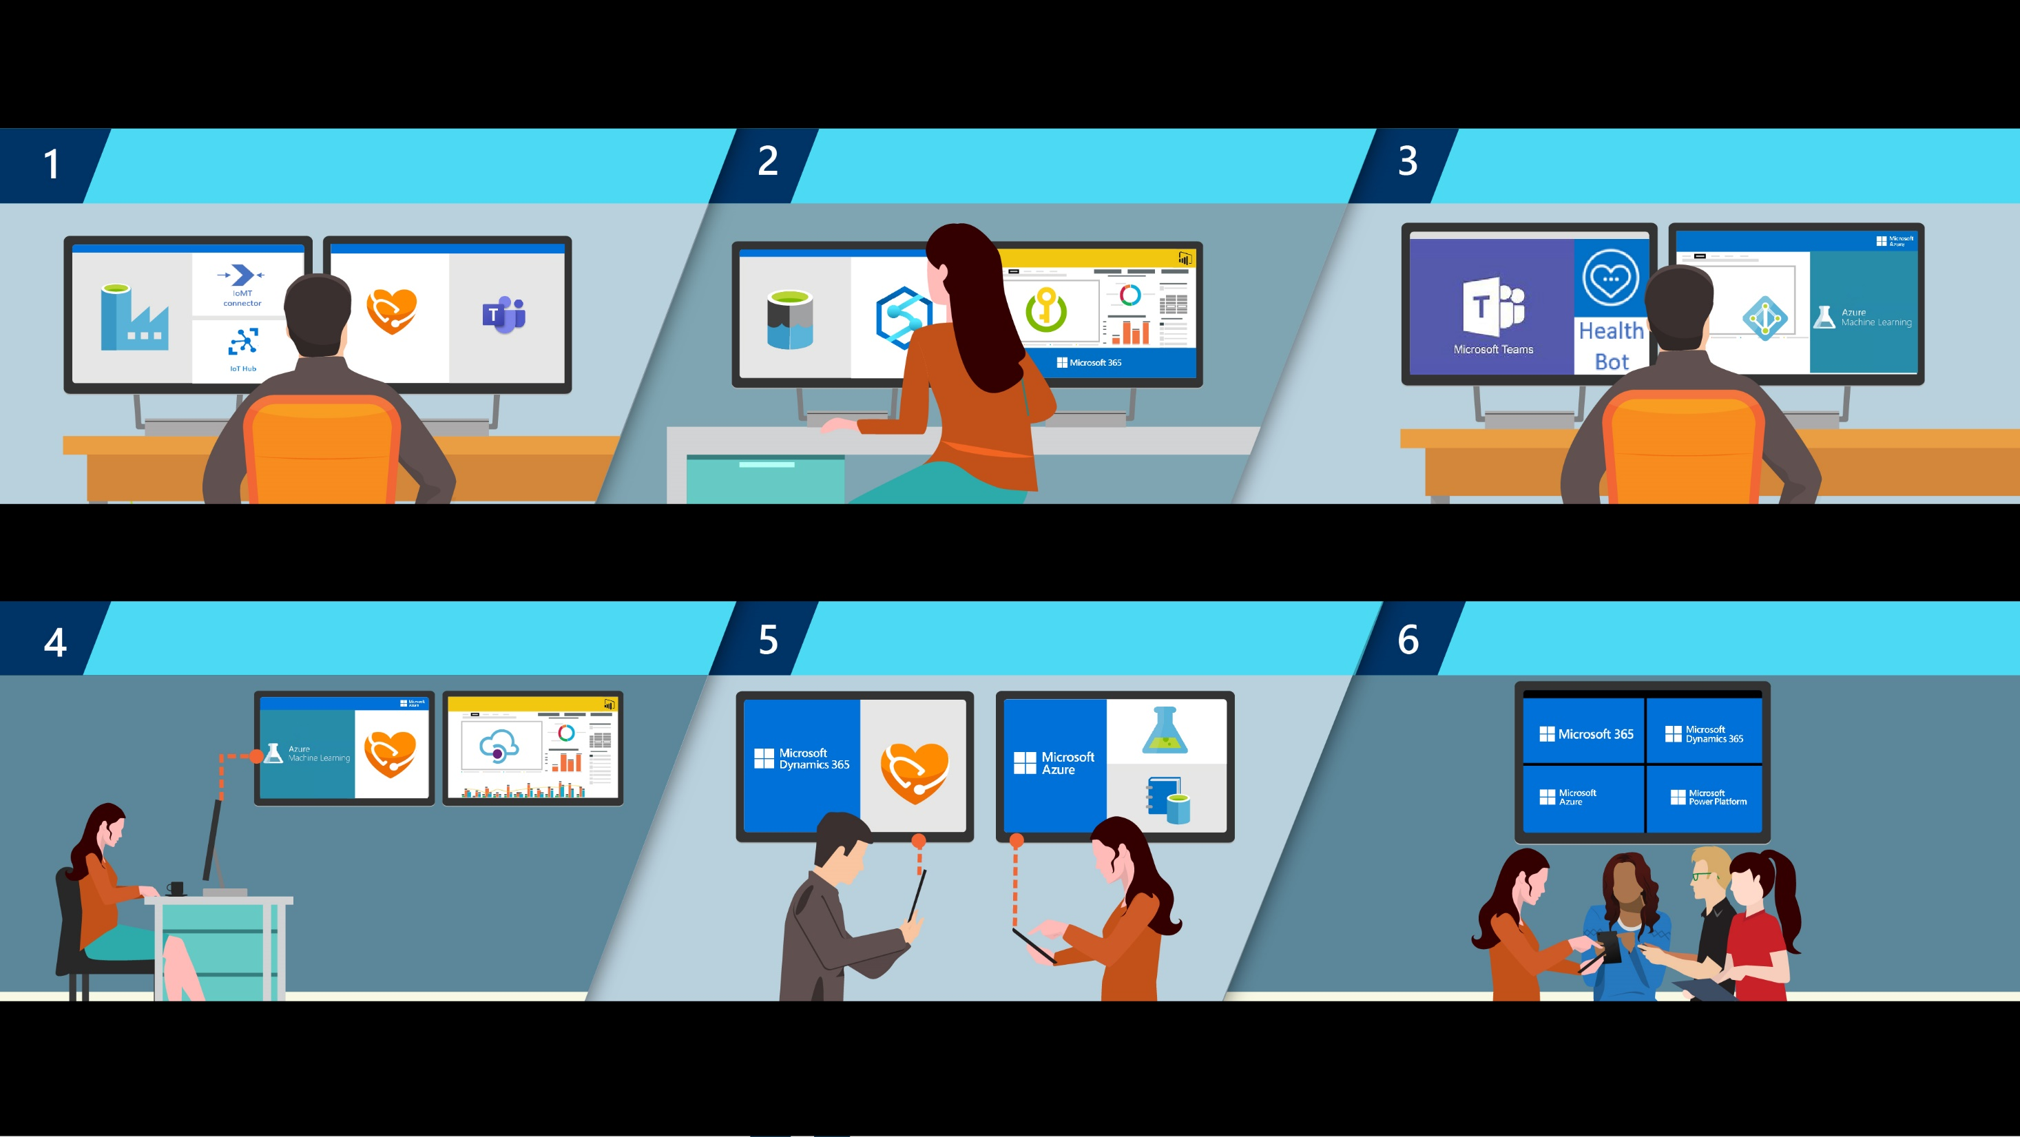
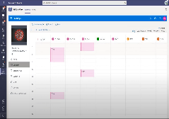











Healthcare Partner journey
Accelerate time to value by leveraging Industry platform capabilities
Build on secure compliant infrastructure and apps to gain insights
Extend intelligent business technologies and solutions into vertically-aligned apps
Azure IoT Connector for FHIR
Azure API for FHIR
Teams productivity canvas
Power BI dashboards
Admin, clinical, diagnostic, and medication CDMs
Advanced security & compliance
Microsoft Healthcare Bot
IoT Hub
Azure Data Factory
Azure Data Lake Storage
Azure Key Vault
Secret & Certificate Management
Azure Active Directory
Authentication
RBAC
Azure Machine Learning Studio
Pre-configurations
Example Training Datasets
Synapse
Empower partners with predictive analytics, actionable apps, and interoperability
Deliver pioneering and innovative solutions with analytics and diagnostics
Partner with Microsoft to demonstrate and realize joint customer value
Azure API for FHIR
CRUD Operations
Search
Partner with Microsoft Building and extending the Microsoft Cloud for Healthcare
Azure API Mgmt
AuthN, AuthZ
Routing, Caching
Azure Machine Learning Studio
Pre-configurations
Azure Machine Learning Studio
Pre-configurations
Azure Data Catalog
Metadata Mgmt.
Lineage Tracking
Core healthcare cloud capability
Other MS services & capabilities leveraged
© 2020 Microsoft Corporation All rights reserved

Slide 39

Partner benefits
Build
Accelerate
Unlock
Build on healthcare-specific standards & capabilities
Accelerate development and time to market
Unlock revenue and services opportunities
Leverage Microsoft global cloud scale to help enable privacy, security and compliance
Build on and extend to a managed platform with cross-cloud engineering accountability
Develop or customize bespoke applications for connected collaboration, workflow, and insights
Accelerate your app development with pre-built Healthcare configurations, dashboards, and admin, patient and clinical CDMs
Build co-sell ready, vertically-aligned apps that extend cloud capabilities into your SaaS apps
Leverage HL7 FHIR compliant APIs and connectors
Deliver functional implementations with high margin, value-add services for structuring usable data and governance
Explore Microsoft Partner programs to develop co-sell ready applications
Drive connected cloud interoperability across workflow, data, and analytics
333
994
320M
34M
16
483
OOB dashboards, workflows,
& extensions
Healthcare bot messages
Customers enabled
Microsoft Teams meetings
Healthcare specific entities
Active customer and partner tenets
In Microsoft Teams virtual health early access program
By healthcare customers in April, including virtual visits and virtual rounding scenarios
Admin, clinical, diagnostic and medication data models
Building on Private Preview of the Microsoft Cloud for Healthcare
Including integrations for Microsoft Teams, Healthcare Bot, and IoT
From 31 million users in 23 countries globally since beginning of March

Slide 40
Partner benefits deep dive
Data & AI
IoT
Teams experiences | capabilities | Canvas
Forms | CDM | Templates
Bring together and transform customer clinical, patient, and IoT systems of record at scale for BI and reporting
Connect, manage, and monitor medical wearables with Continuous patient monitoring IoT template, Azure API for FHIR, and Azure IoT Connector for FHIR
Integrate out-of-the-box or customized experiences with Microsoft Teams collaboration and intelligent meeting experiences, on a secure and compliant platform
Utilize Dynamics 365 apps with pre-built Patient 360 and Provider 360 care team and timeline forms
Harness Azure data, and Healthcare AI & ML capabilities to meet the evolving needs of the Healthcare industry
Create Microsoft Teams virtual care capabilities for virtual consults and virtual visits from clinical systems
Utilize standard libraries, templates, and common integration patterns for a connective solution experience
Leverage an ecosystem of trusted hardware partners that provide hundreds of IoT certified devices
Built-in device management and provisioning to connect and manage IoT devices at scale
Drive business process innovation for customers, leveraging pre-built workflows and tools for Power Platform within Microsoft Teams collaboration canvas
Build secure IoT apps and devices with bi-directional communication and authentication, extending it from the cloud to the edge
Leverage Healthcare CDMs based on HL7 FHIR standards and accrue benefits across Microsoft Dynamics 365, Microsoft Teams, Microsoft Power Platform, and your first party apps
Drive business process innovation for customers, leveraging pre-built workflows and tools for Power Platform with Teams collaboration canvas
Build and deploy Healthcare Bot for AI-powered, compliant, conversational healthcare experiences
Ingest, store, and share health data in the cloud with built-in support for health standards like FHIR
© 2020 Microsoft Corporation All rights reserved
40

